Slide 1





Nested model
WG – Assertions and Extensible Tokens
SPIFFE/SPIRE
October/2023

Slide 2
Agenda
Metrics and Objectives
Tools
Samples and Test Environment
ID-mode and Anonymous mode

Slide 3
Introduction
Metrics:
Data payload
Runtime
Resources (CPU / Memory)

Slide 4
Objective
In a broad point-of-view:
Identify and capture data related to the performance and overhead of the nested token
Characterize a behaviour baseline based on experiments with a batch of sequential requests
Estimate the effects of the token extension through the middle-tiers

Slide 5
Metrics
Data Payload:
Assertions Size (Delta / Tiers)
Certificates Size (SVIDs)
Signature Size (Schnorr / ECDSA)

Slide 6
Metrics
Runtime:
Token mint and nesting time
Token validation

Slide 7
Metrics
Resources:
CPU consumption in percentage
Memory consumption in MB

Slide 8

Prometheus + PoC
Open-source monitoring tool
GoLang Client
50ms scrapes
PoC:
Metrics collection instrument integrated on the PoC code
Directly measuring the requests on the APIs

Slide 9


Apache JMeter + Rstudio
Open-source tool for load test functional behavior and measure performance on web apps
Sequential requests (one every 6 seconds)
Easy way to test stress load on the app
IDE for processing the collected data using R

Slide 10

Test Environment
Ubuntu Server - 06
Ubuntu 20.04
Processor: Intel(R) Core(TM) i7-4770 CPU @ 3.40GHz - 8 cores
RAM memory: 32 GB
Each container with 1vCPU and 128MB of RAM memory
Ubuntu Server - 04
Processor: Intel(R) Xeon(R) CPU E5-2620 @ 2.00GHz - 24 cores
RAM memory: 192 GB

Slide 11
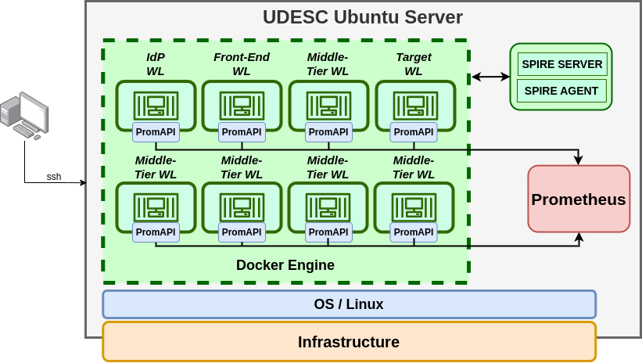
Test Environment

Slide 12
Tests
Proof of concept
Automated requests with JMeter
The test was conducted with:
Both PoC models with 5 middle-tiers
100 requests warm-up for cache prior to the tests
100 requests in a 10 minute period (batch of 10 tests with 10 requests - 1 every 6 seconds)
Information captured every 50ms through Prometheus API

Slide 13
Results - Payload - Both machines
Assertion Growth (Bytes)
ID-Mode - SVIDs Certificates Size (Bytes)
 | Subject | M-tier1 | M-tier2 | M-tier3 | M-tier4 | M-tier5
ID-Mode | 570 | 799 | 1030 | 1261 | 1492 | 1720
Growth | - | +229 | +231 | +231 | +231 | +228
AnonMode | 346 | 538 | 731 | 924 | 1117 | 1310
Growth | - | +192 | +193 | +193 | +193 | +193
 | Subject | M-tier1 | M-tier2 | M-tier3 | M-tier4 | M-tier5 | Target
SVIDs | 781 | 1558 | 2339 | 3120 | 3901 | 4682 | 5463

Slide 14
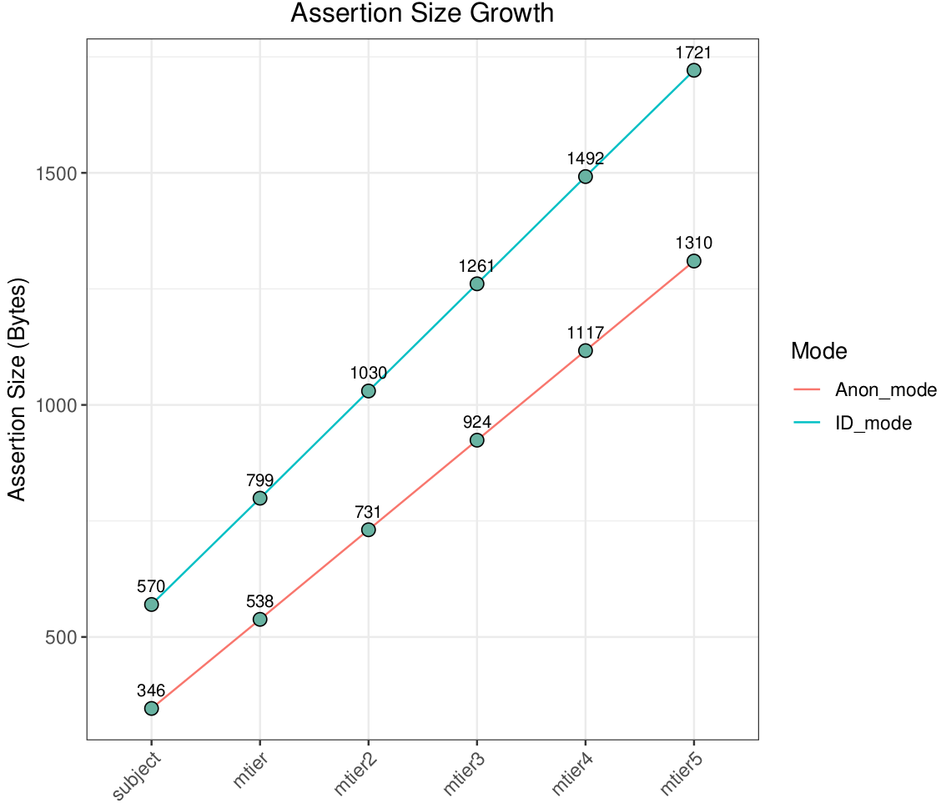
Results
Payload
Intel i7-4770

Slide 15
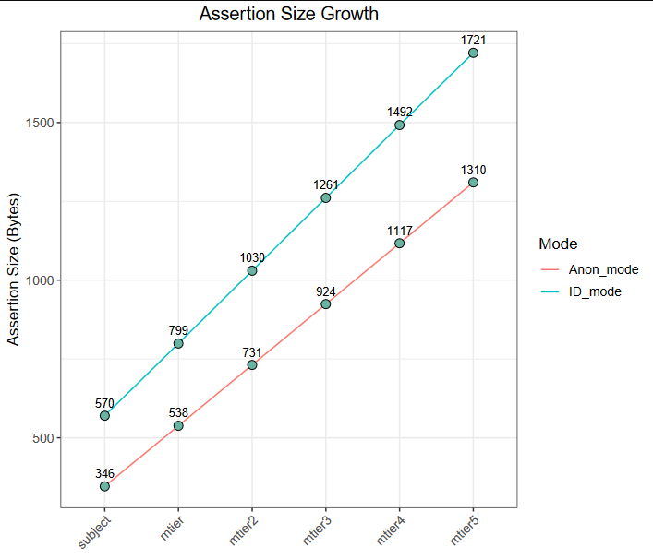
Results
Payload
Xeon E5-2620

Slide 16
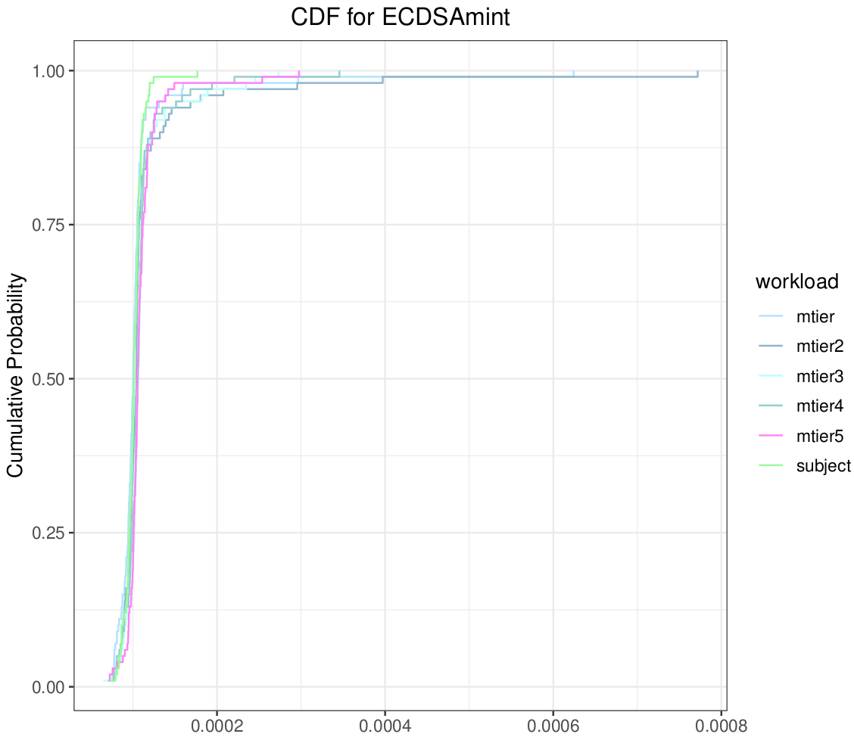
Results - Runtime
ID-Mode token mint
Intel i7-4770
Workload | Mean (µs)
subject | 101.51 ∓ 11.74
m-tier | 107.09 ∓ 57.39
m-tier2 | 116.80 ∓ 77.04
m-tier3 | 110.63 ∓ 29.86
m-tier4 | 109.90 ∓ 31.17
m-tier5 | 109.96 ∓ 11.74

Slide 17
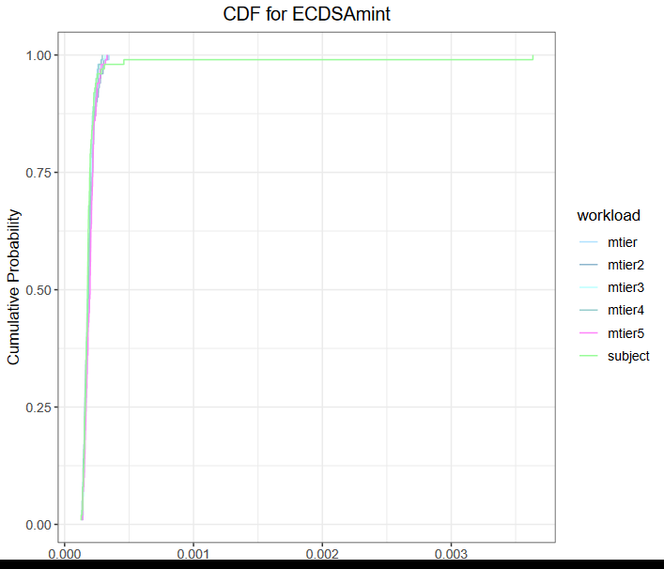
Results - Runtime
ID-Mode token mint
Xeon E5-2620
Workload | Mean (µs)
subject | 217.85 ∓ 347.56
m-tier | 187.26 ∓ 34.39
m-tier2 | 189.86 ∓ 41.57
m-tier3 | 189.69 ∓ 36.34
m-tier4 | 188.54 ∓ 36.60
m-tier5 | 196.26 ∓ 38.60

Slide 18
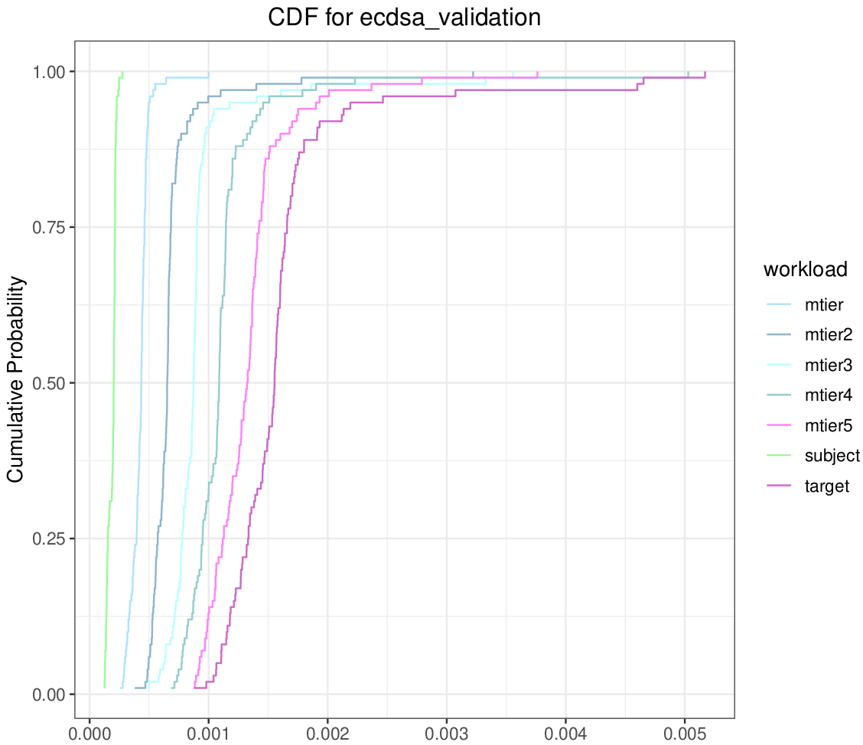
Results - Runtime
ID-Mode token validation
Intel i7-4770
Workload | Mean (µs)
subject | 189.74 ∓ 33.91
m-tier | 425.97 ∓ 86.24
m-tier2 | 688.07 ∓ 307.89
m-tier3 | 913.03 ∓ 403.99
m-tier4 | 1122.37 ∓ 456.01
m-tier5 | 1340.49 ∓ 381.92
target | 1618.77 ∓ 642.68
+236
+262
+225
+209
+218
+279

Slide 19
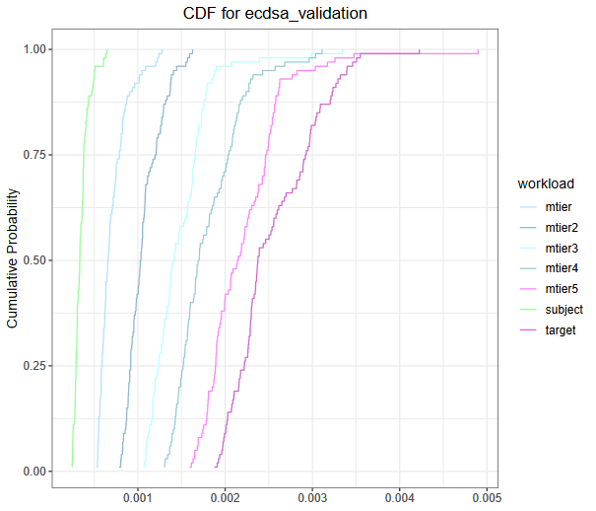
Results - Runtime
ID-Mode token validation
Xeon E5-2620
Workload | Mean (µs)
subject | 351.23 ∓ 84.56
m-tier | 708.39 ∓ 166.30
m-tier2 | 1067.33 ∓ 195.27
m-tier3 | 1482.79 ∓ 352.94
m-tier4 | 1800.60 ∓ 376.99
m-tier5 | 2209.10 ∓ 466.36
target | 2554.14 ∓ 472.53
+357
+358
+415
+317
+408
+345

Slide 20
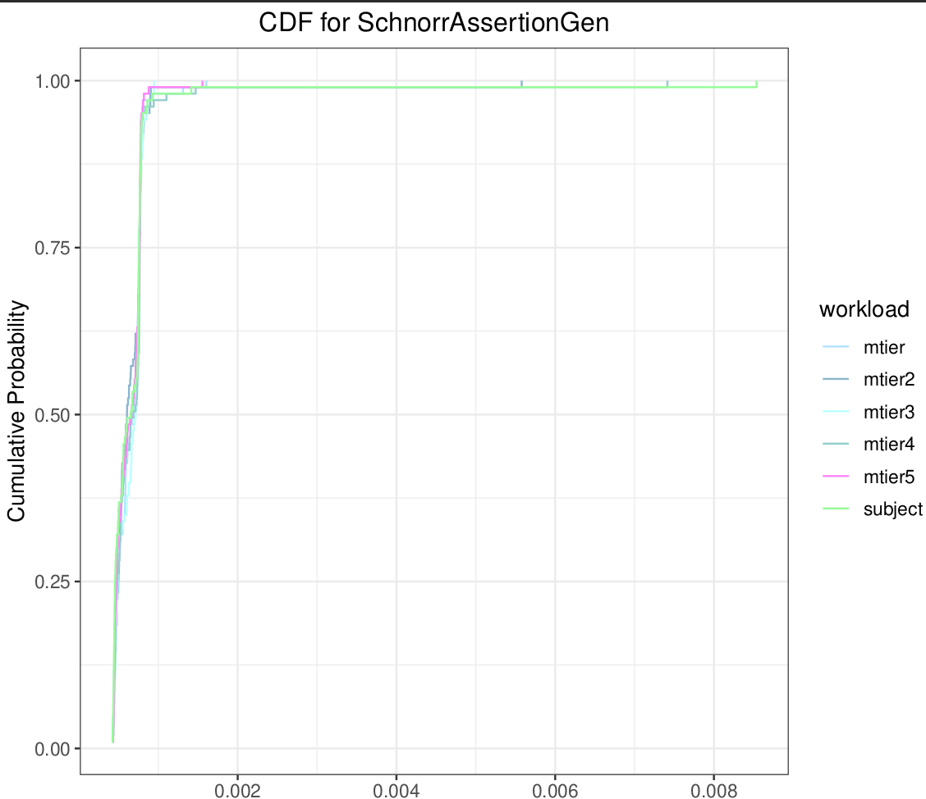
Results - Runtime
Anon-Mode token mint
Intel i7-4770
Workload | Mean (µs)
subject | 702.86 ∓ 796.99
m-tier | 648.13 ∓ 179.22
m-tier2 | 673.31 ∓ 507.93
m-tier3 | 652.32 ∓ 144.94
m-tier4 | 710.90 ∓ 688.04
m-tier5 | 633.17 ∓ 167.44

Slide 21
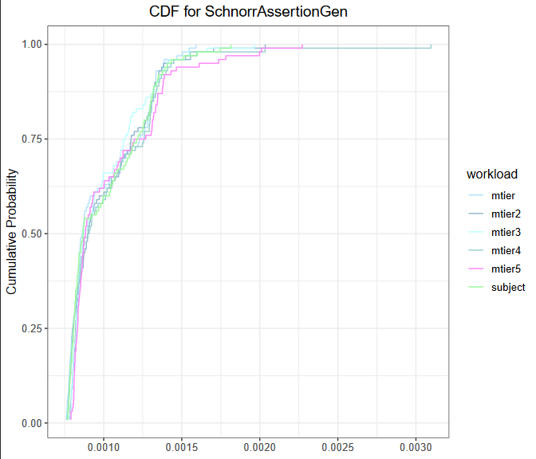
Results - Runtime
Anon-Mode token mint
Xeon E5-2620
Workload | Mean (µs)
subject | 1007.86 ∓ 249.23
m-tier | 992.66 ∓ 234.94
m-tier2 | 1015.00 ∓ 246.85
m-tier3 | 995.63 ∓ 234.02
m-tier4 | 1030.39 ∓ 325.15
m-tier5 | 1039.24 ∓ 302.70

Slide 22
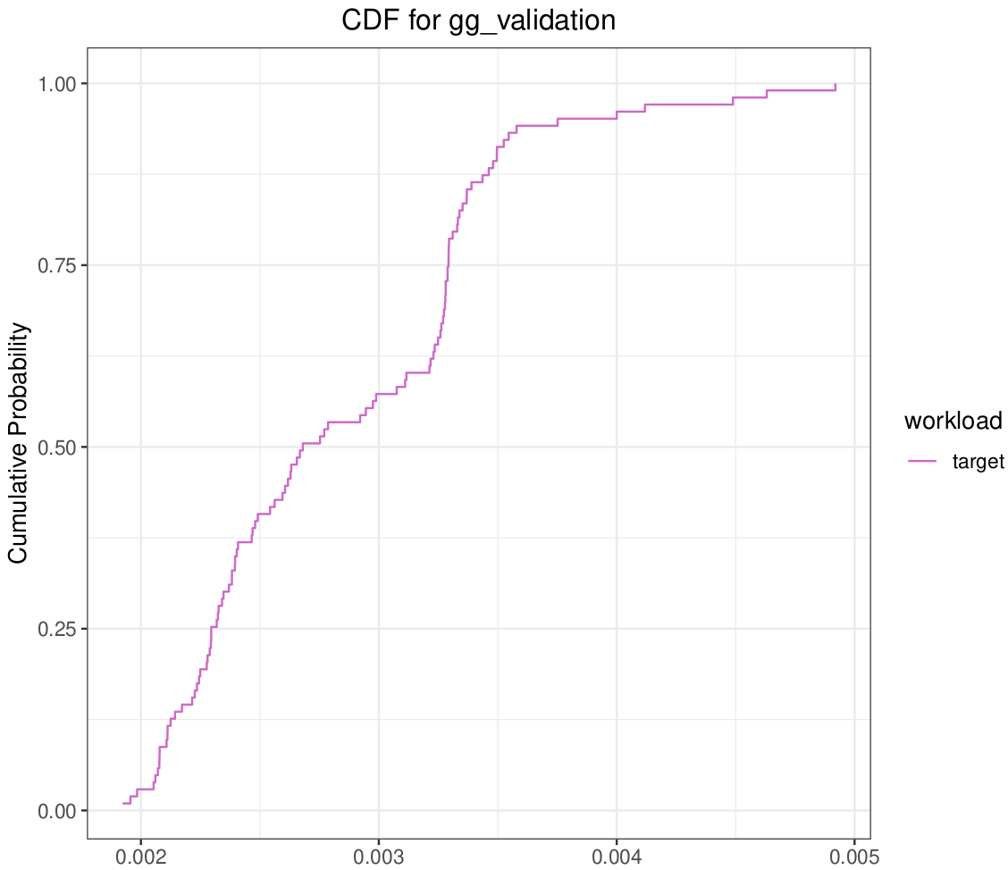
Results - Runtime
Anon-Mode token validation
Intel i7-4770
The validation scheme of anonymous-mode using galindo-garcia had a mean value of 2.842 milliseconds with a standard deviation of 624.57 µs.

Slide 23
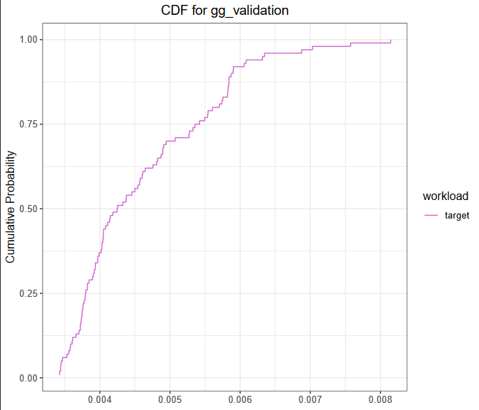
Results - Runtime
Anon-Mode token validation
Xeon E5-2620
The validation scheme of anonymous-mode using galindo-garcia had a mean value of 4.616 milliseconds with a standard deviation of 1.01 ms.

Slide 24
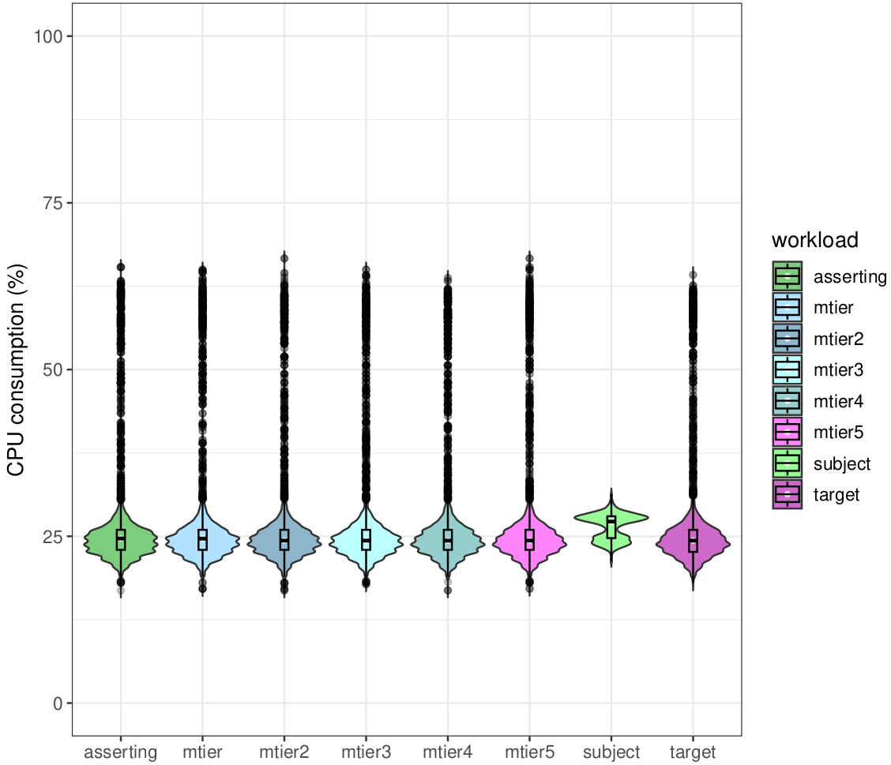
Results
ID Mode - CPU
(idle)
Intel i7-4770

Slide 25
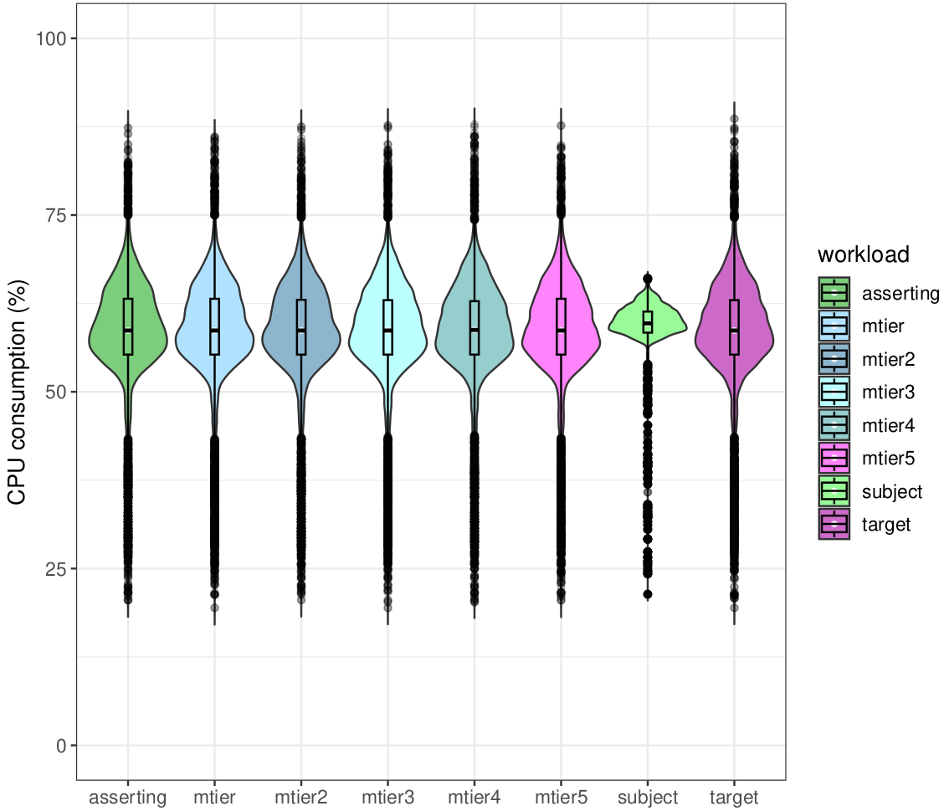
Results
ID Mode - CPU
(under load)
Intel i7-4770

Slide 26
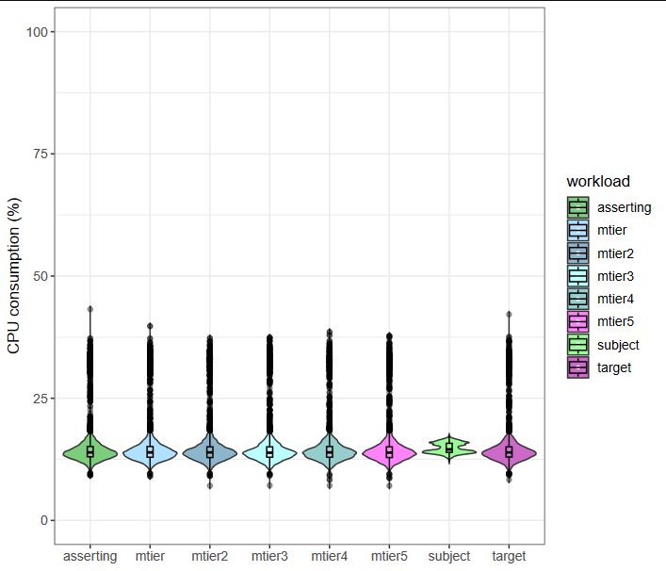
Results
ID Mode - CPU
(idle)
Intel Xeon E5-2620

Slide 27
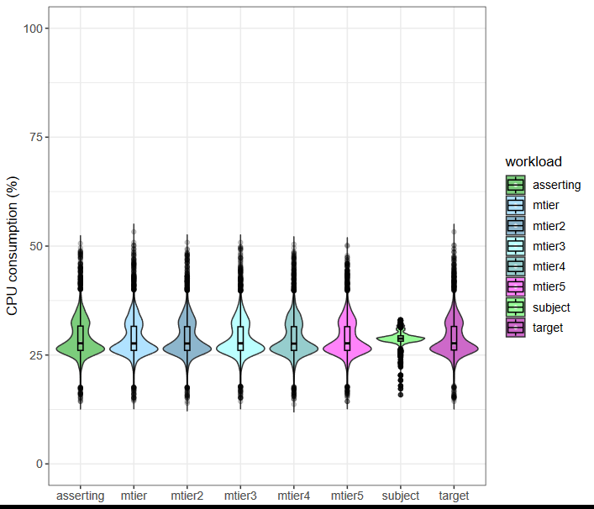
Results
ID Mode - CPU
(under load)
Intel Xeon E5-2620

Slide 28
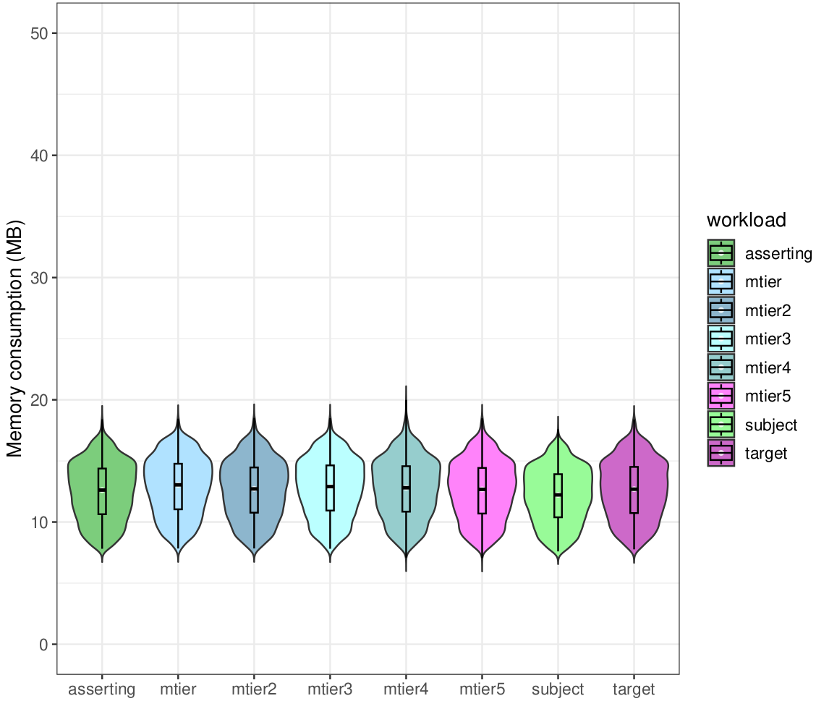
Results
ID Mode -Memory
(idle)
Intel i7-4770

Slide 29
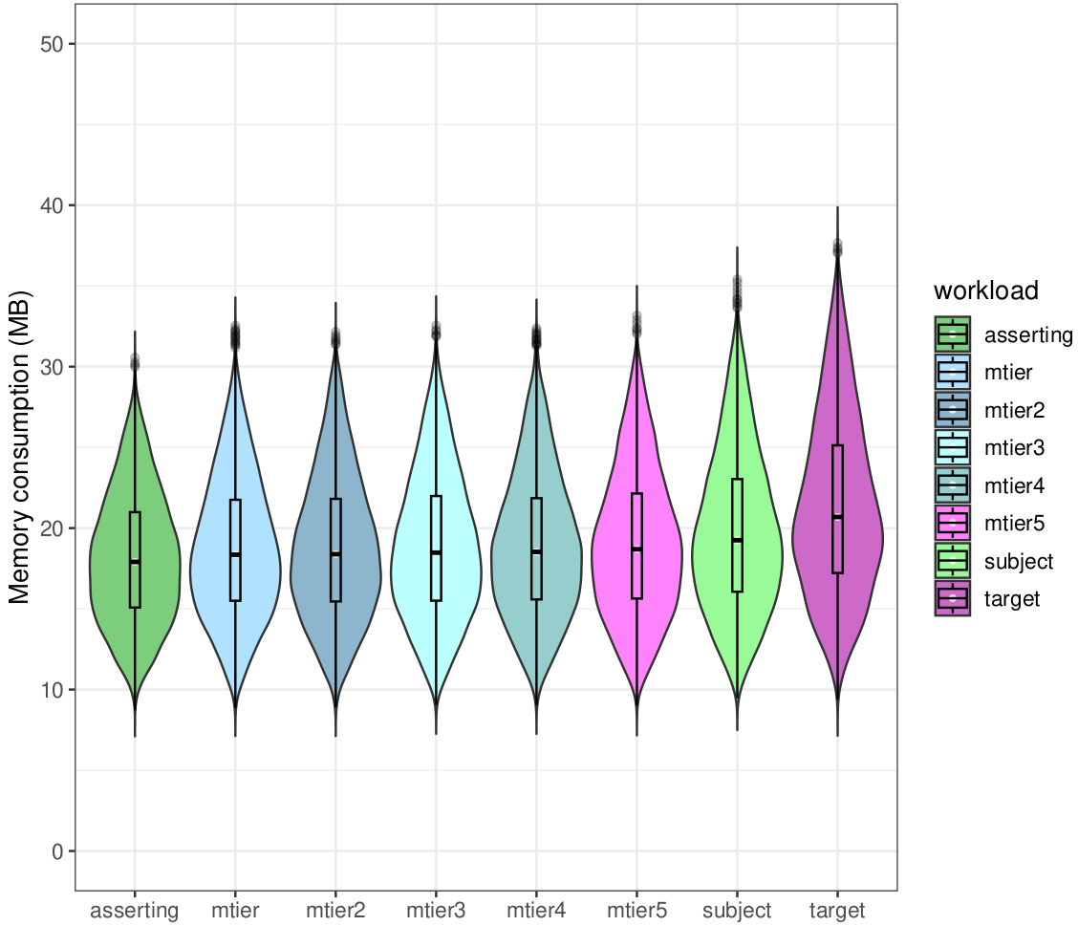
Results
ID Mode -Memory
(under load)
Intel i7-4770

Slide 30
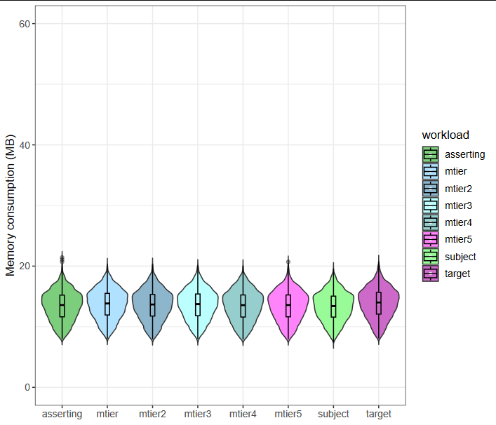
Results
ID Mode -Memory
(idle)
Intel Xeon E5-2620

Slide 31
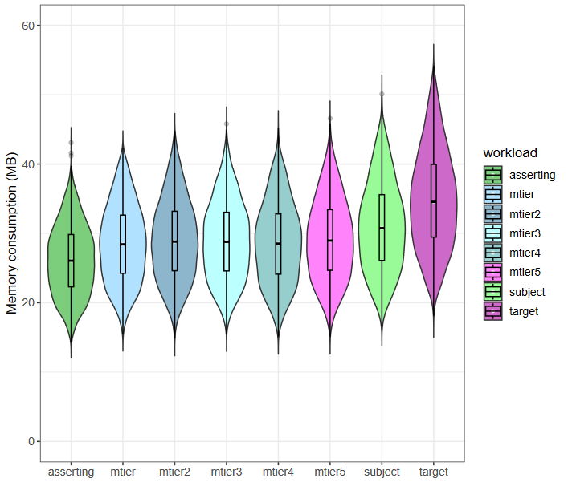
Results
ID Mode -Memory
(under load)
Intel Xeon E5-2620

Slide 32
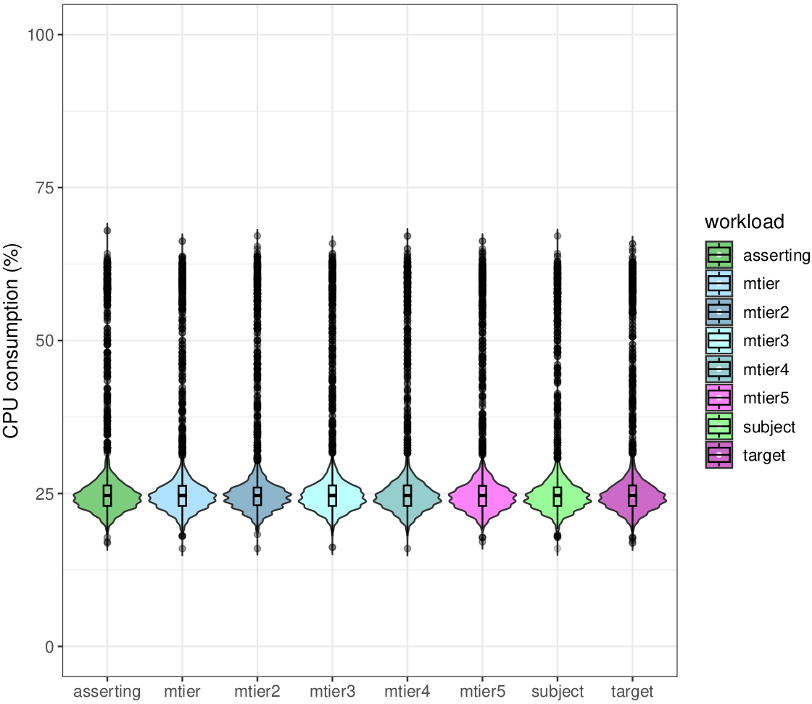
Results
Anon Mode - CPU
(idle)
Intel i7-4770

Slide 33
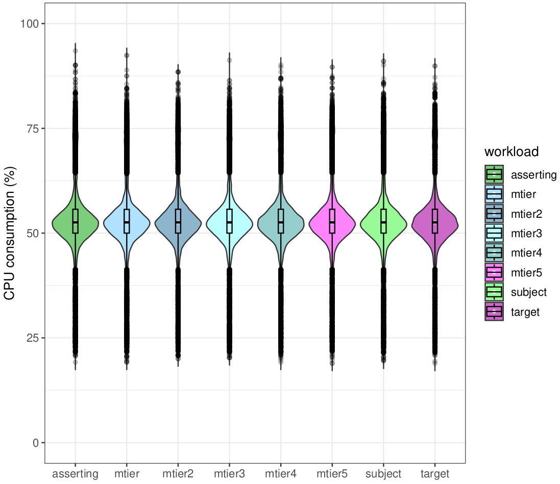
Results
Anon Mode - CPU
(under load)
Intel i7-4770

Slide 34
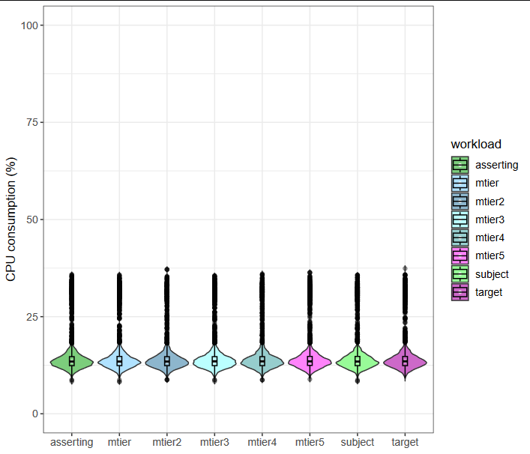
Results
Anon Mode - CPU
(idle)
Intel Xeon E5-2620

Slide 35
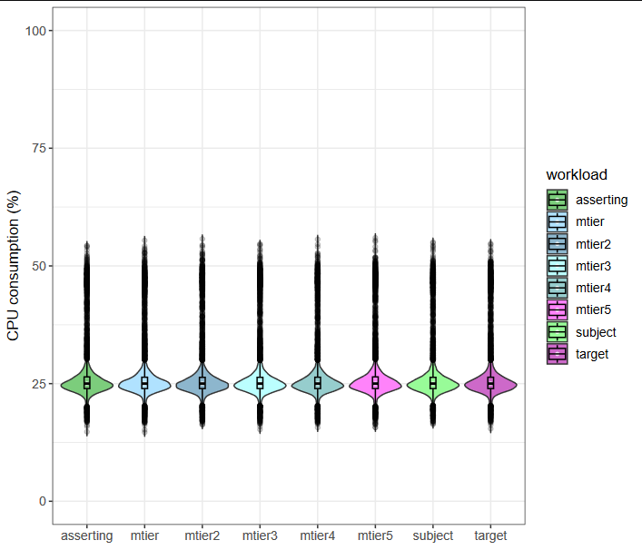
Results
Anon Mode - CPU
(under load)
Intel Xeon E5-2620

Slide 36
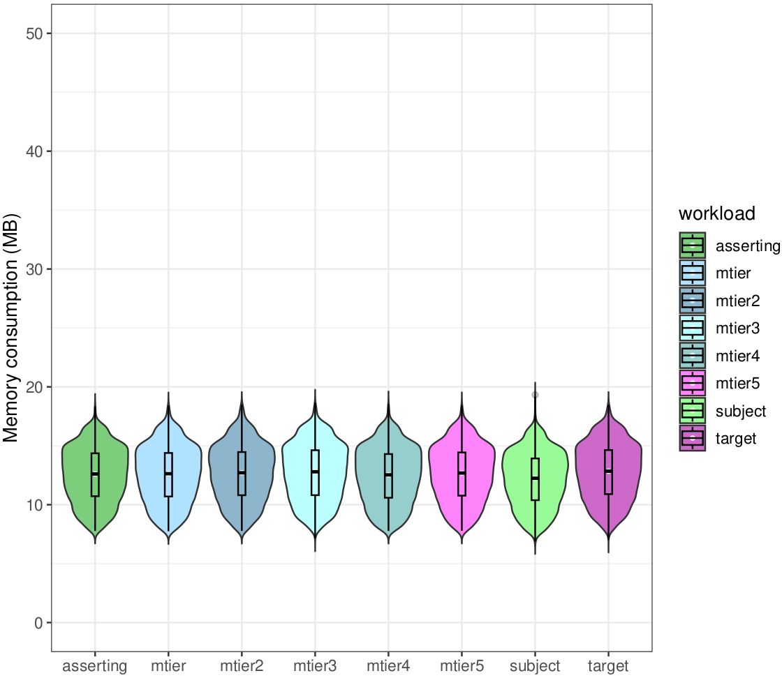
Results
Anon Mode -Memory
(idle)
Intel i7-4770

Slide 37
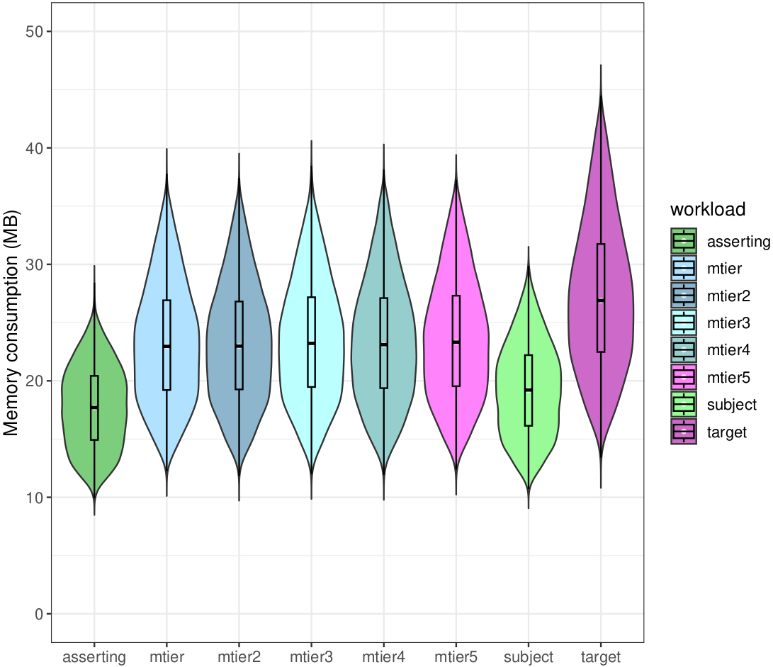
Results
Anon Mode -Memory
(under load)
Intel i7-4770

Slide 38
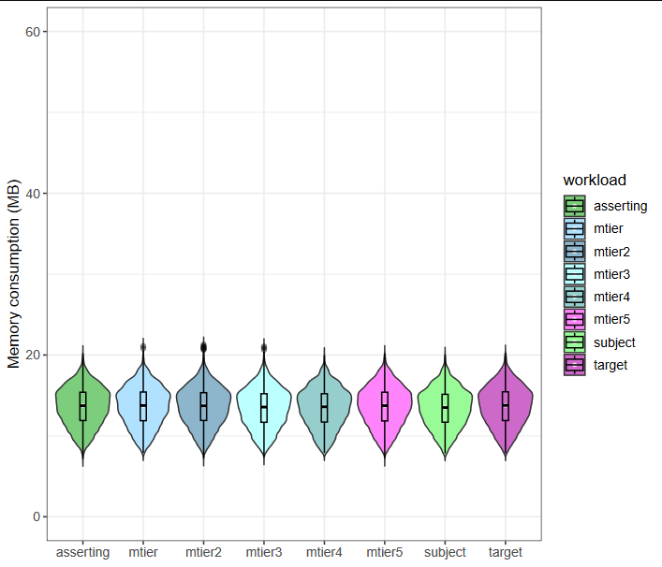
Results
Anon Mode -Memory
(idle)
Intel Xeon E5-2620

Slide 39
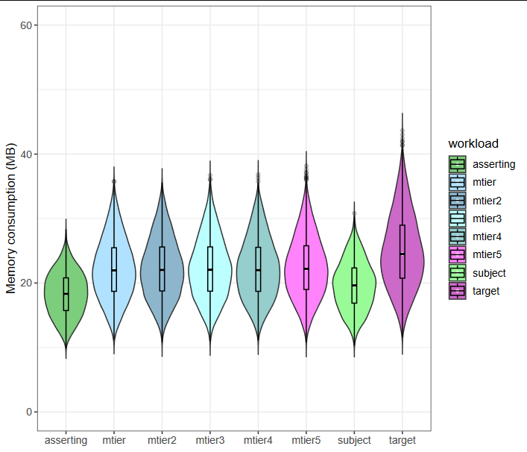
Results
Anon Mode -Memory
(under load)
Intel Xeon E5-2620

Slide 40
Future work
Provide a branch for the instrumentation of the PoC on our project repository.
The development of the PoC using the LSVID and instrumenting the new model with Prometheus.

Slide 41

Thanks!

